Slide 1
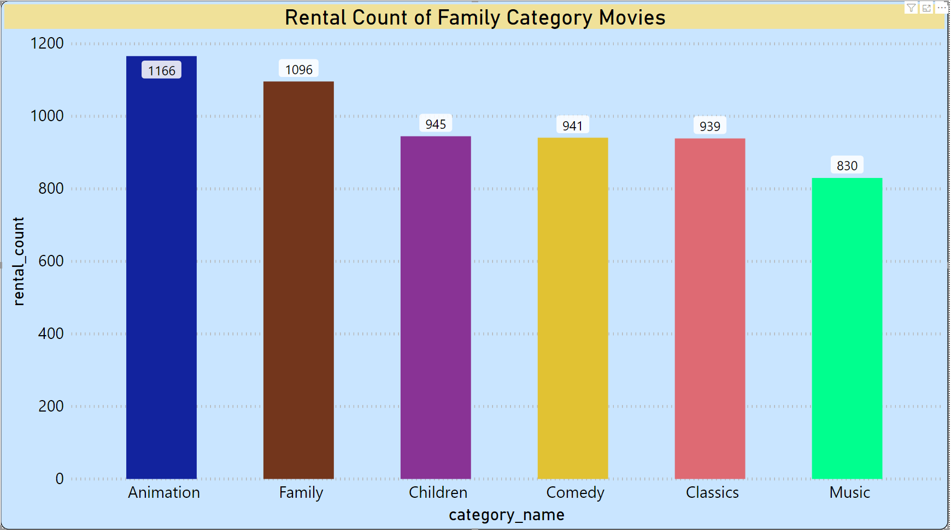
UNDERSTANDING TREND OF FAMILY CATEGORY MOVIES
Question Of Interest
We want to understand more about the movies that families are watching. Which movie category is likely to be rented the most and least based on the data available? Also explain any trend in the movie rental particularly rented for family watching?
Summary
It is evident from the data plotted on a graph, that movies related to Animation genre has been rented out the most whereas movies related to Music genre has been rented out the least. Therefore, movies related to Animation will likely to be rented the most whereas Music will be rented out the least. Also Movies in Children, classic and comedy are averagely rented.

Slide 2
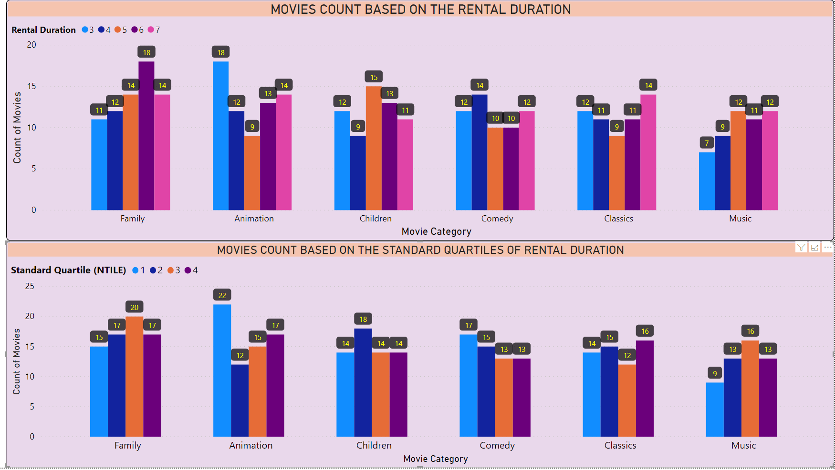
UNDERSTANDING RENTAL DURATION AND STANDARD QUARTILES OF MOVIES
Question Of Interest
What are length of category wise rental duration of movies which the families are watching? Also compare the number of movies in each quartile for each category?
Summary
The graphs illustrated here explains the trend of movies which families are watching wrt Rental Duration and Standard Quartiles. The first graphs enumerates that in ‘Family’ Category 18 movies have been rented for 6 days whereas 18 movies of ‘Animation’ Category have been rented for 3 days, which are the highest compared to others. Further, in terms of Standard Quartiles, the Animation Category has the highest movies in 1st Quartile whereas 20 movies of Family category are in third quartile.

Slide 3
UNDERSTANDING THE PERFORMANCE OF STORES IN YEAR 2005 AND 2006
Question Of Interest
We want to find out how Rental stores are performing? Find out the performance of stores in each year and month towards rental of movies?
Summary
It is evident that only two stores have been renting out the movies in 2005 and 2006 (the data available with us). It is pertinent that both stores have been performing equally in terms of movies rented by them.
Further, it is clearly visible that in July 2005 maximum number of movies have been rented out by the stores (Store 1 – 3334 and Store 2 – 3375 ) whereas in year 2006 the number has gone down drastically to 92/90 for the Store1/ Store2

Slide 4
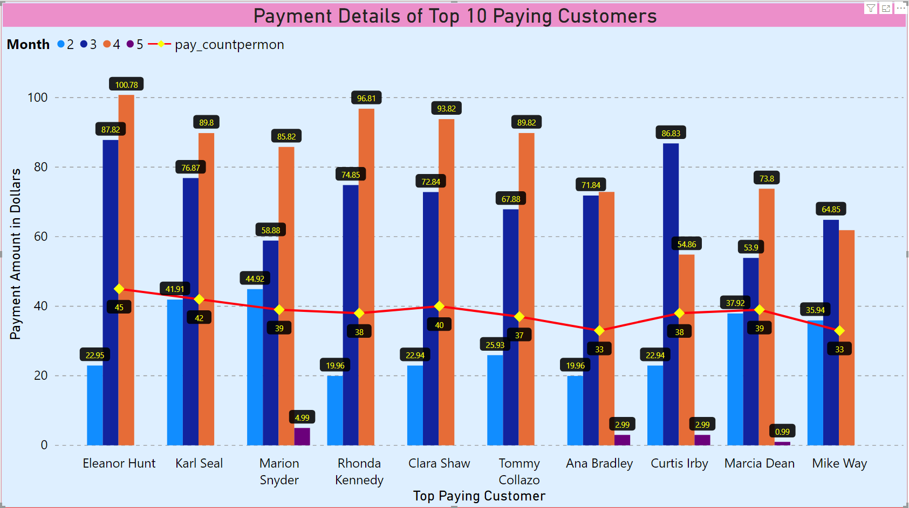
UNDERSTANDING THE TOP PAYING CUSTOMERS
Question Of Interest
We want to understand about the Customers who have been paying the most? Find out the top 10 customers who have paid the most towards renting a movie? Also find out the no. of monthly payments of these customers ?
Summary
The data plotted on a clustered graph illustrates the top 10 paying customers. Also it can be observed that ‘Eleanor Hunt’ is ranked 1 in terms of paying highest amount. In addition, the total no. of payment transacted by him are 45, where the maximum payment in a month has occurred in the month of April 2007 (of net 100.78 dollars). It can also be observed that for all customers maximum transactions has occurred in the month of April whereas very few has occurred in May 2007

